Slide 1
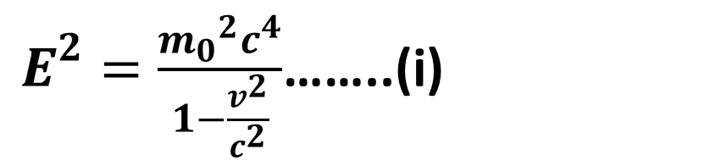
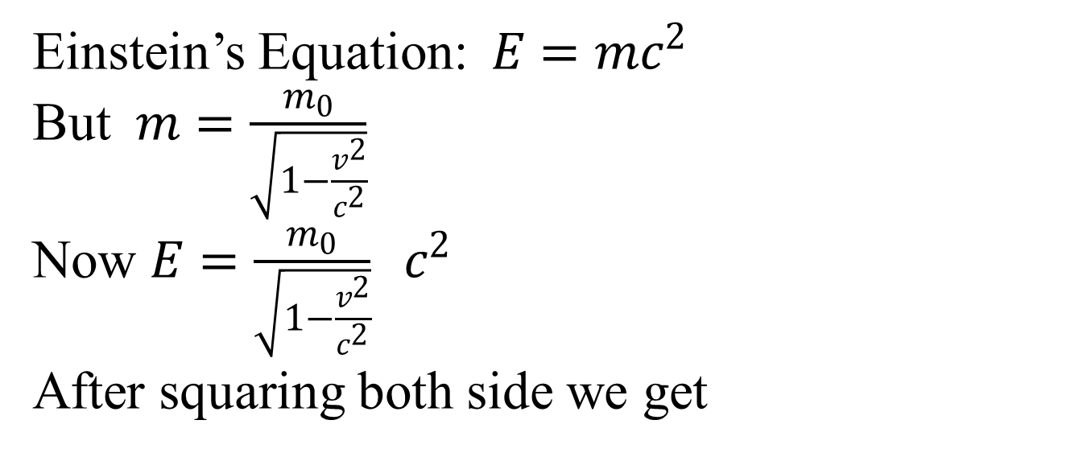
Relativistic Energy and Momentum
Einstein’s Equation: $E=mc^{2}$
But $m=\frac{m_{0}}{\sqrt{1−\frac{v^{2}}{c^{2}}}}$
Now $E=\frac{m_{0}}{\sqrt{1−\frac{v^{2}}{c^{2}}}} c^{2}$
After squaring both side we get
$E^{2}=\frac{{m_{0}}^{2}c^{4}}{1−\frac{v^{2}}{c^{2}}}$……..(i)

Slide 2
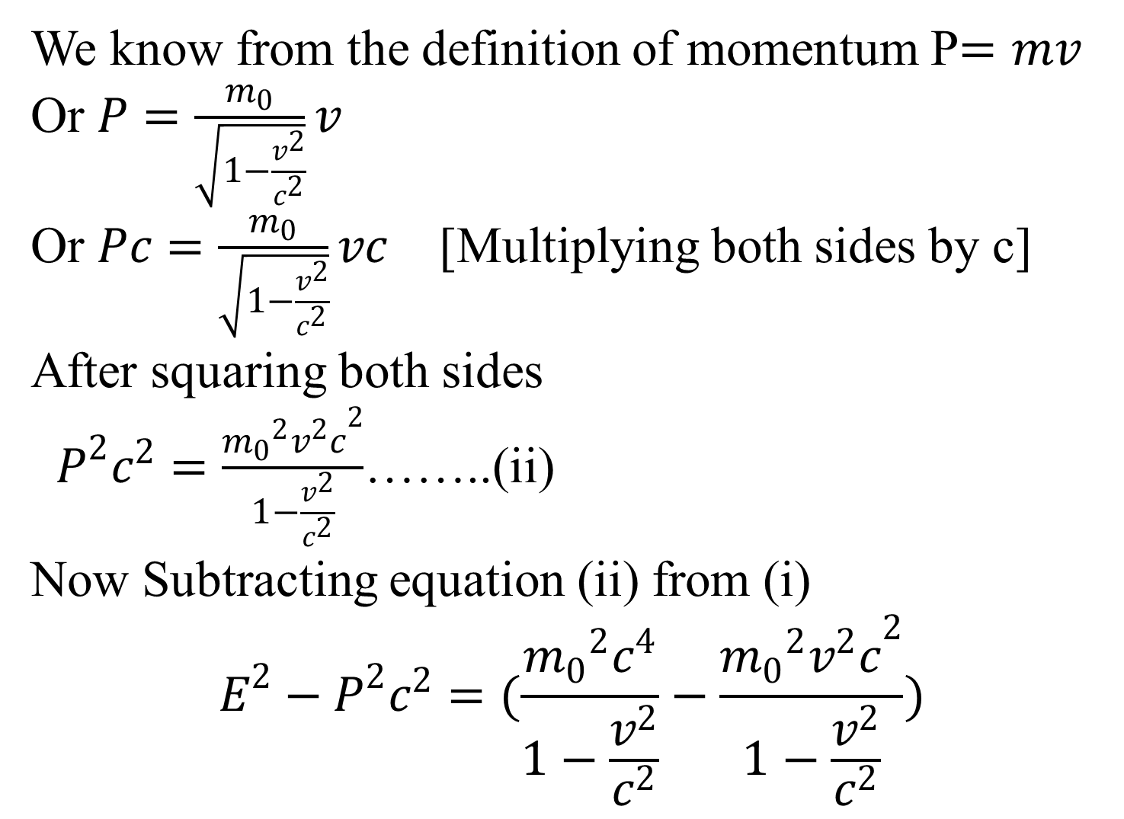
We know from the definition of momentum P$=mv$
Or $P=\frac{m_{0}}{\sqrt{1−\frac{v^{2}}{c^{2}}}}v$
Or $Pc=\frac{m_{0}}{\sqrt{1−\frac{v^{2}}{c^{2}}}}vc$ [Multiplying both sides by c]
After squaring both sides
$P^{2}c^{2}=\frac{{m_{0}}^{2}{v^{2}c}^{2}}{1−\frac{v^{2}}{c^{2}}}$……..(ii)
Now Subtracting equation (ii) from (i)
$$E^{2}−P^{2}c^{2}=(\frac{{m_{0}}^{2}c^{4}}{1−\frac{v^{2}}{c^{2}}}−\frac{{m_{0}}^{2}{v^{2}c}^{2}}{1−\frac{v^{2}}{c^{2}}})$$

Slide 3
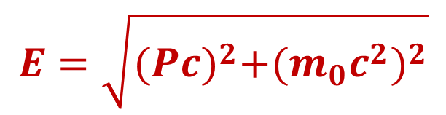
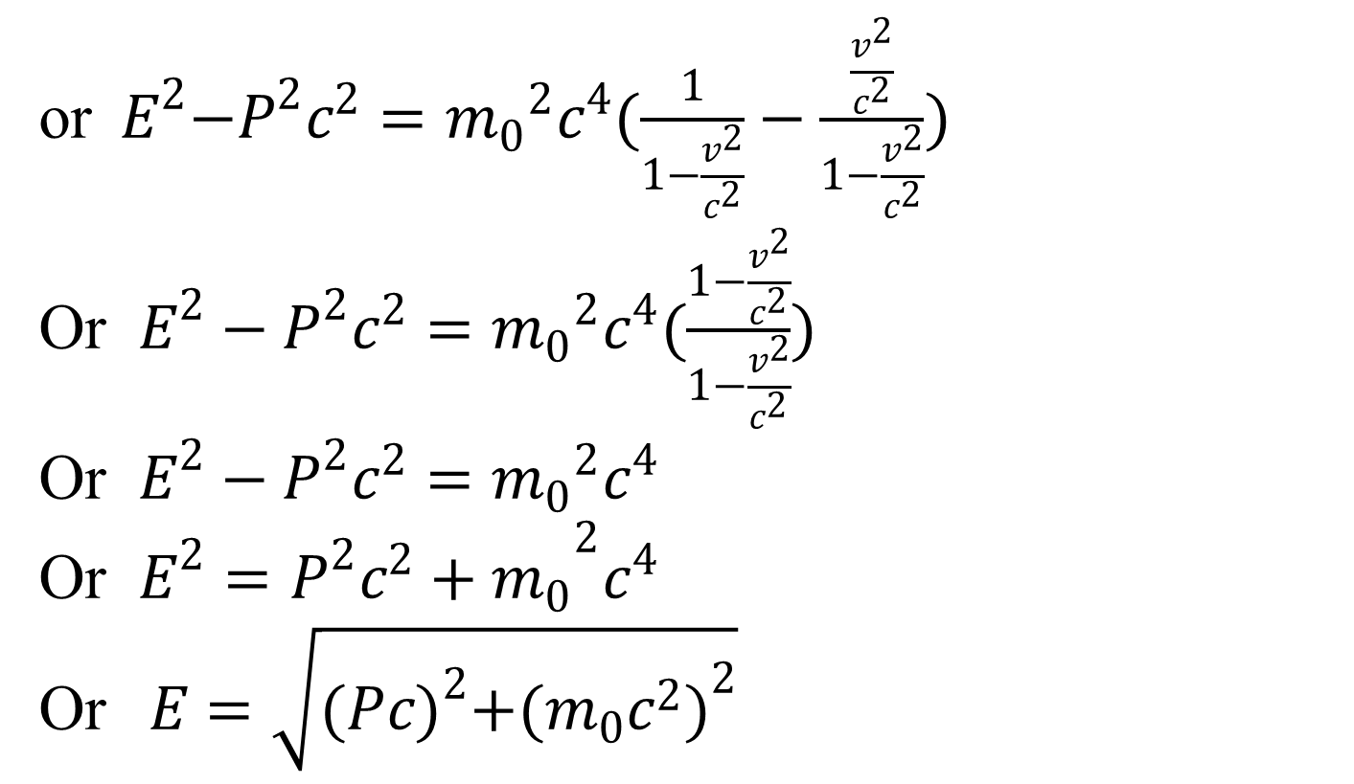
or${ E}^{2}−P^{2}c^{2}={m_{0}}^{2}c^{4}(\frac{1}{1−\frac{v^{2}}{c^{2}}}−\frac{\frac{v^{2}}{c^{2}}}{1−\frac{v^{2}}{c^{2}}})$
Or $E^{2}−P^{2}c^{2}={m_{0}}^{2}c^{4}(\frac{1−\frac{v^{2}}{c^{2}}}{1−\frac{v^{2}}{c^{2}}})$
Or $E^{2}−P^{2}c^{2}={m_{0}}^{2}c^{4}$
Or $E^{2}={P^{2}c^{2}+m_{0}}^{2}c^{4}$
Or$E=\sqrt{{(Pc)}^{2}+{(m_{0}c^{2})}^{2}}$
$$E=\sqrt{{(Pc)}^{2}+{(m_{0}c^{2})}^{2}}$$
This equation is known as the relation between relativistic energy and momentum

Slide 4
Heisenberg's Uncertainty Principle
Heisenberg's Uncertainty Principle states that there is inherent uncertainty in the act of measuring a variable of a particle. Commonly applied to the position and momentum of a particle, the principle states that the more precisely the position is known the more uncertain the momentum is and vice versa.

Slide 5
if one knows the precise momentum of the particle, it is impossible to know the precise position, and vice versa. This relationship also applies to energy and time, in that one cannot measure the precise energy of a system in a finite amount of time.
Uncertainties in the products of “conjugate pairs” (momentum/position) and (energy/time) were defined by Heisenberg as having a minimum value corresponding to Planck’s constant divided by 4π.

Slide 6
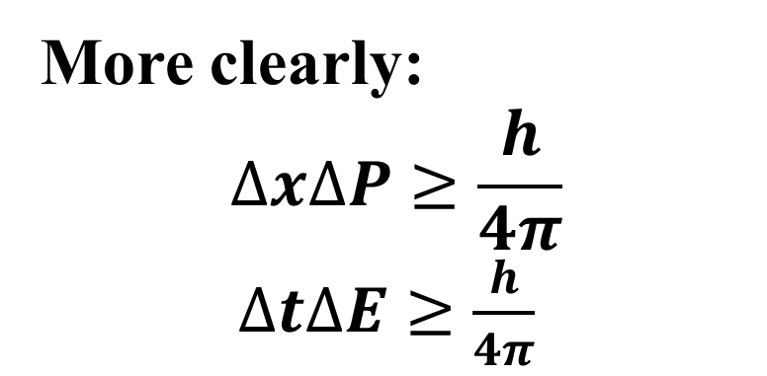
More clearly:
$$∆x∆P≥\frac{h}{4π}$$
$∆t∆E≥\frac{h}{4π}$
Ex-1: The uncertainty in the momentum Δp of a football thrown by Tom Brady during the super bowl traveling at 40m/s is 1×10⁻⁶ times of its momentum. What is its uncertainty in position Δx? Mass=0.40kg

Slide 7
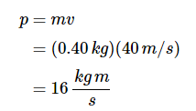
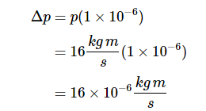
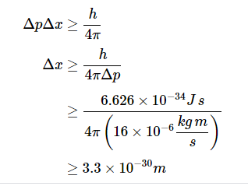

Slide 8
Electron can not exist in the nucleus . We can assume it by uncertainty principle.
Usually we can measure the energy of orbital electron in atom in eV range . Till now energy in MeV or GeV range has not been found. So electron having MeV or GeV can not be existed in nucleus.

Slide 9
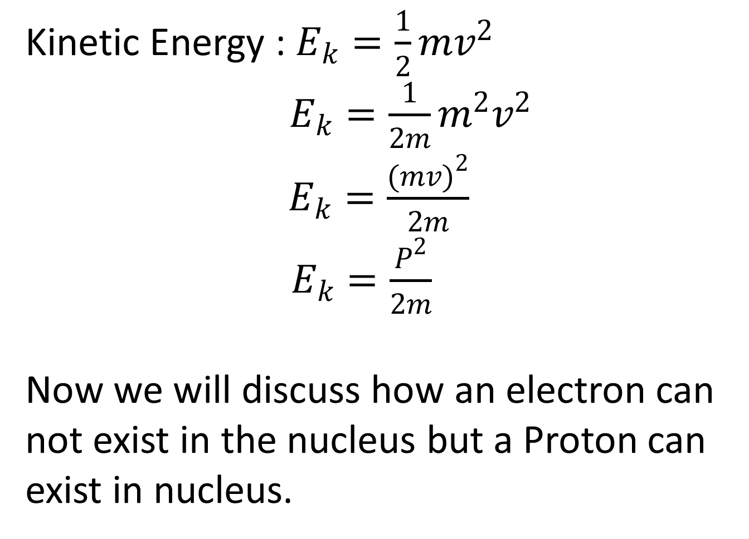
Kinetic Energy : $E_{k}=\frac{1}{2}mv^{2}$
$E_{k}=\frac{1}{2m}m^{2}v^{2}$
$E_{k}=\frac{{(mv)}^{2}}{2m}$
$E_{k}=\frac{P^{2}}{2m}$
Now we will discuss how an electron can not exist in the nucleus but a Proton can exist in nucleus.

Slide 10
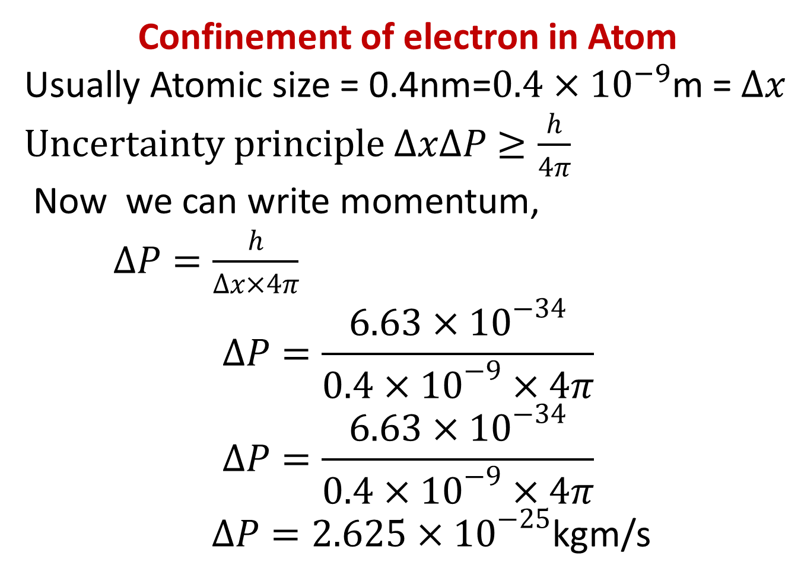
Confinement of electron in Atom
Usually Atomic size = 0.4nm=$0.4×{10}^{−9}$m = $∆x$ $Uncertainty principle ∆x∆P≥\frac{h}{4π}$
Now we can write momentum,
$∆P=\frac{h}{∆x×4π}$
$$∆P=\frac{6.63×{10}^{−34}}{0.4×{10}^{−9}×4π}$$
$$∆P=\frac{6.63×{10}^{−34}}{0.4×{10}^{−9}×4π}$$
$∆P=2.625×{10}^{−25}$kgm/s

Slide 11
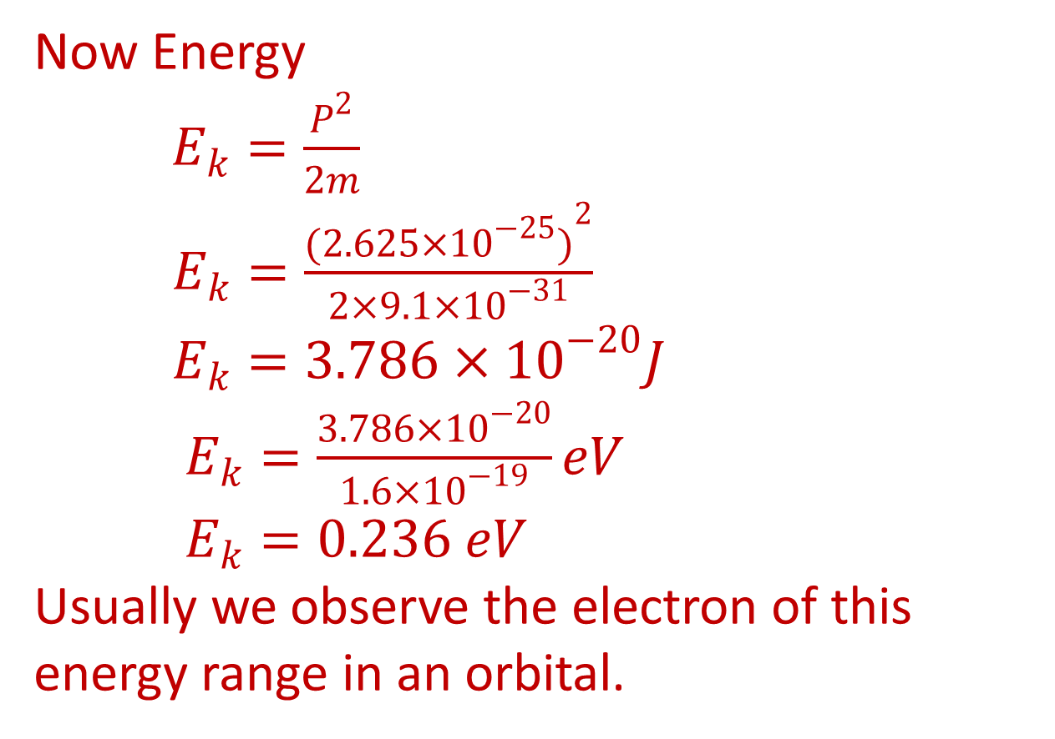
Now Energy
$E_{k}=\frac{P^{2}}{2m}$
$E_{k}=\frac{{(2.625×{10}^{−25})}^{2}}{2×9.1×{10}^{−31}}$
$E_{k}=3.786×{10}^{−20}J$
$E_{k}=\frac{3.786×{10}^{−20}}{1.6×{10}^{−19}}eV$
$E_{k}=0.236 eV$
Usually we observe the electron of this energy range in an orbital.

Slide 12
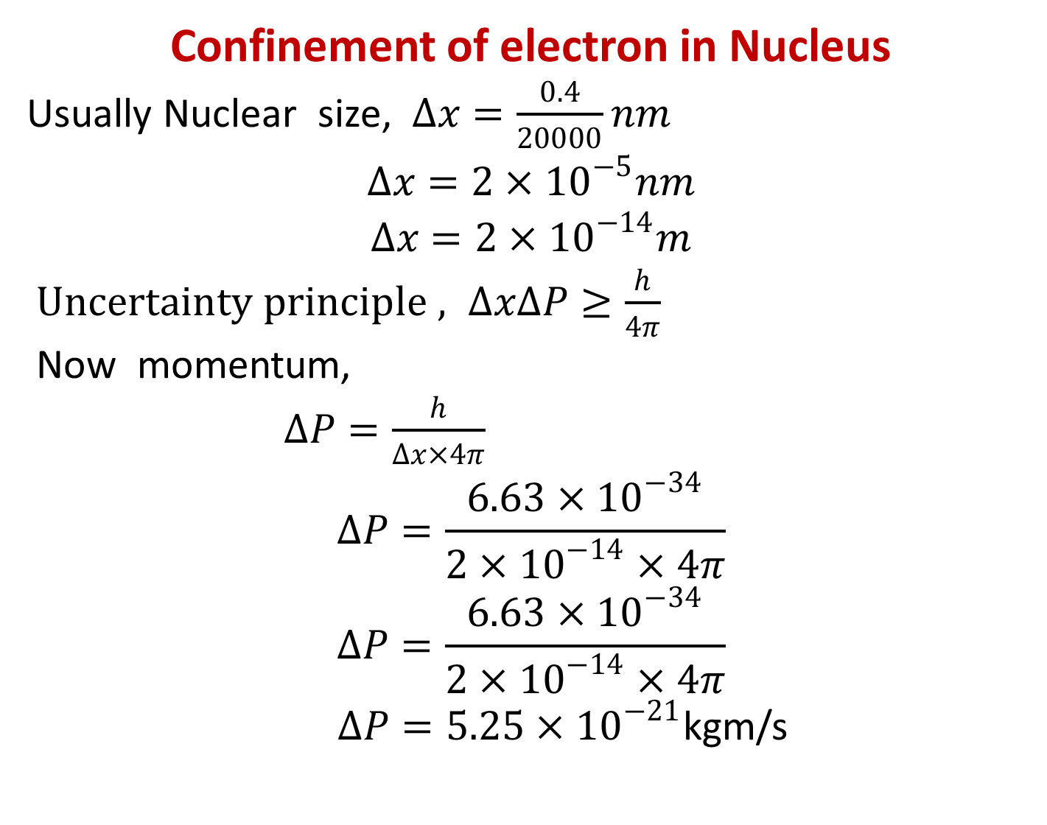
Confinement of electron in Nucleus
Usually Nuclear size, $∆x=\frac{0.4}{20000}nm$
$$∆x=2×{10}^{−5}nm$$
$$∆x=2×{10}^{−14}m$$
$Uncertainty principle , ∆x∆P≥\frac{h}{4π}$
Now momentum,
$∆P=\frac{h}{∆x×4π}$
$$∆P=\frac{6.63×{10}^{−34}}{2×{10}^{−14}×4π}$$
$$∆P=\frac{6.63×{10}^{−34}}{2×{10}^{−14}×4π}$$
$∆P=5.25×{10}^{−21}$kgm/s

Slide 13
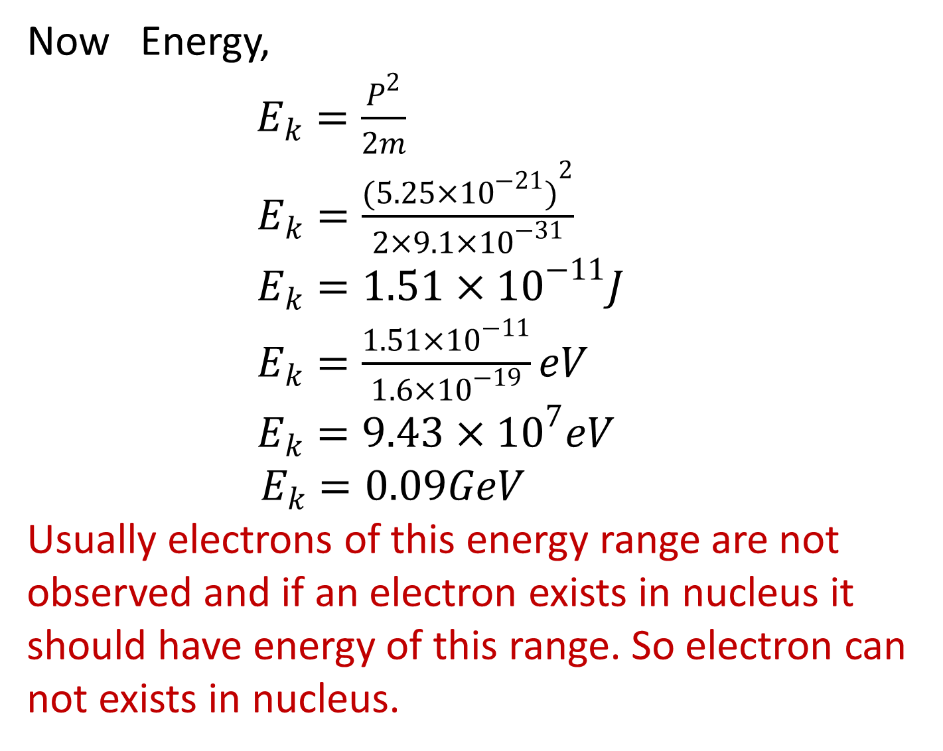
Now Energy,
$E_{k}=\frac{P^{2}}{2m}$
$E_{k}=\frac{{(5.25×{10}^{−21})}^{2}}{2×9.1×{10}^{−31}}$
$E_{k}=1.51×{10}^{−11}J$
$E_{k}=\frac{1.51×{10}^{−11}}{1.6×{10}^{−19}}eV$
$E_{k}=9.43×{10}^{7}eV$
$E_{k}=0.09GeV$
Usually electrons of this energy range are not observed and if an electron exists in nucleus it should have energy of this range. So electron can not exists in nucleus.

Slide 14
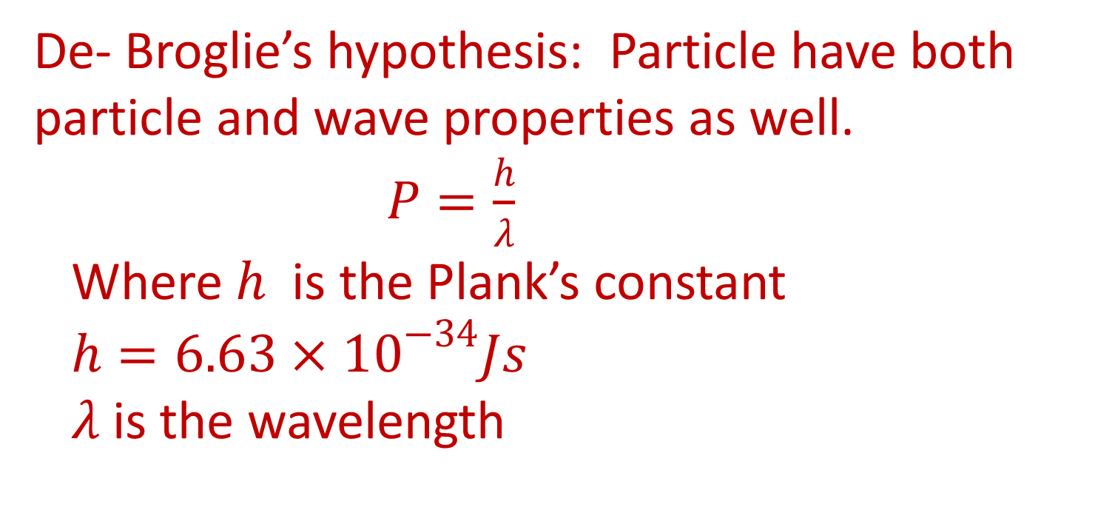
De- Broglie’s hypothesis: Particle have both particle and wave properties as well.
$P=\frac{h}{λ}$
Where $h$ is the Plank’s constant
$h=6.63×{10}^{−34}Js$
$λ$ is the wavelength

Slide 15
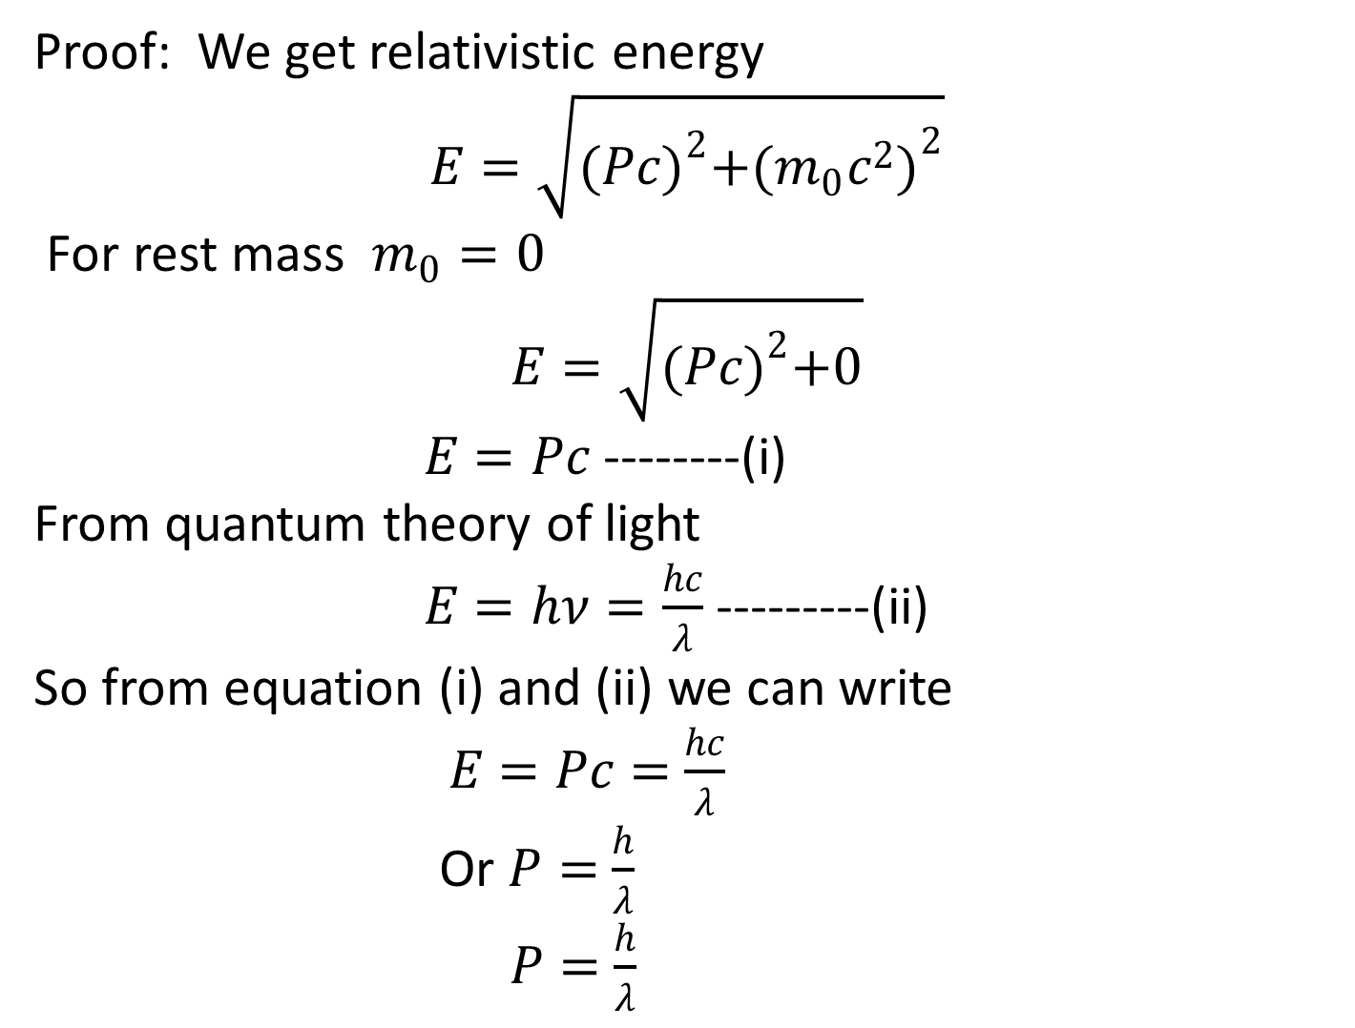
Proof: We get relativistic energy
$$E=\sqrt{{(Pc)}^{2}+{(m_{0}c^{2})}^{2}}$$
For rest mass $m_{0}=0$
$$E=\sqrt{{(Pc)}^{2}+0}$$
$E=Pc$ --------(i)
From quantum theory of light
$E=hν=\frac{hc}{λ}$ ---------(ii)
So from equation (i) and (ii) we can write $E=Pc=$ $\frac{hc}{λ}$
Or $P=$ $\frac{h}{λ}$
$P=$ $\frac{h}{λ}$

Slide 16
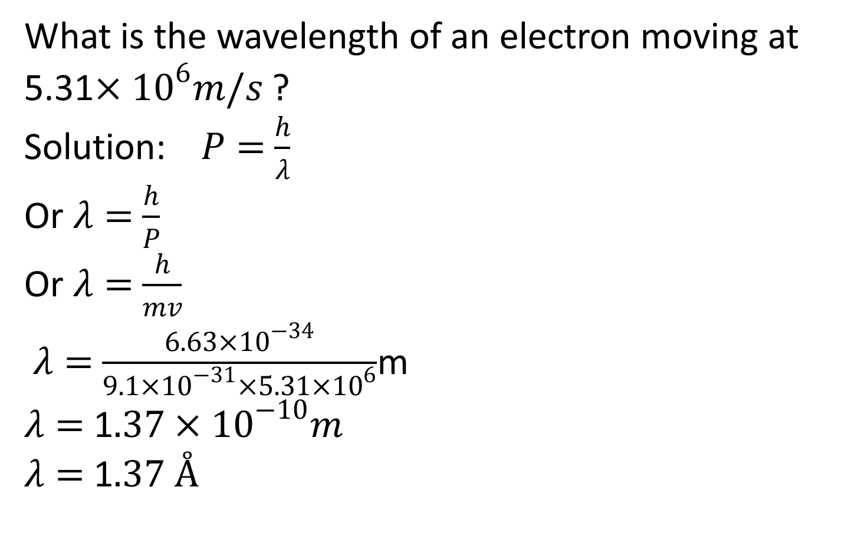
What is the wavelength of an electron moving at 5.31$×{10}^{6}m/s$ ?
Solution: $P=$ $\frac{h}{λ}$
Or $λ=$ $\frac{h}{P}$
Or $λ=$ $\frac{h}{mv}$
$λ=$ $\frac{6.63×{10}^{−34}}{9.1×{10}^{−31}×5.31×{10}^{6}}$m
$λ=$ 1$.37×{10}^{−10}m$
$λ=$ 1$.37 Å$

